Slide 1
Bootstrap 4 - Welcome Section
In depth bootstrap 4 course by Ivan Marchenko

Slide 2
Who is this course for
You need to be familiar with following technologies
HTML
CSS
JavaScript

Slide 3
Where to find information
https://developer.mozilla.org/en-US/
https://stackoverflow.com/
https://caniuse.com/

Slide 4
What you need for this course
Computer with a modern browser
Text Editor or an IDE
Pen with a notebook
Attitude

Slide 5
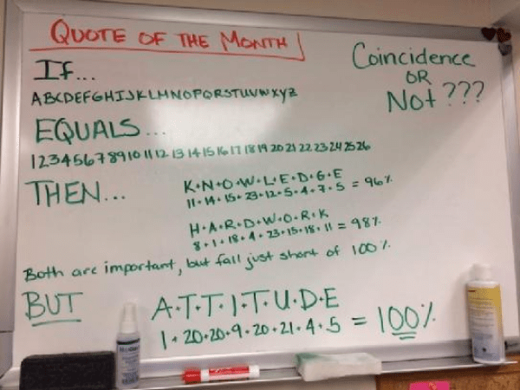
Attitude

Slide 6
Why Bootstrap 4
Lot’s of support
Modern technologies
Backed up by a major company
Lots of users worldwide

Slide 7
Disadvantages of bootstrap
You still need to learn CSS
Ugly UI

Slide 8
What this course will cover
HTML5/CSS4
Bootstrap 4
Sass
Gulp
BEM
JavaScript
Labs
Quizzes

Slide 9
HTML and CSS Recap

